Slide 1
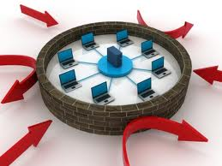
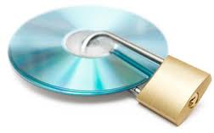
ISO 27001 Information Security Management System (ISMS) Certification Overview
Dr Lami Kaya
LamiKaya@gmail.com

Slide 2
Information Assets
Information is an asset
like other important business assets, has value to an organisation and consequently needs to be suitably protected.
What is Information?
Current Business Plans
Future Plans
Intellectual Property (Patents, etc)
Employee Records
Customer Details
Business Partners Records
Financial Records

Slide 3
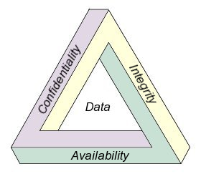
What is Information Security?
Information Security addresses
Confidentiality ( C )
Integrity ( I )
Availability (A)
Also involves
Authenticity
Accountability
Non-repudiation
Reliability

Slide 4
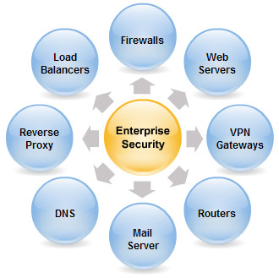
Enterprise/Corporate IT Hardware Resources

Slide 5
Information Security Risks
The range of risks exists
System failures
Denial of service (DOS) attacks
Misuse of resources
Internet/email /telephone
Damage of reputation
Espionage
Fraud
Viruses/spy-ware etc
Use of unlicensed software

Slide 6

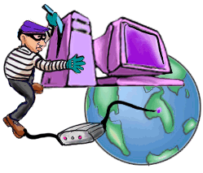
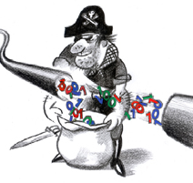
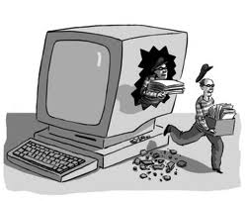
Hacking & Leaking & Stealing Risks

Slide 7
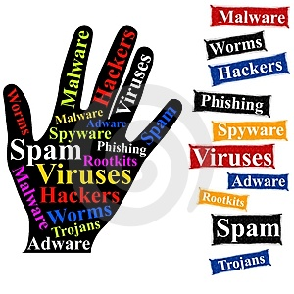
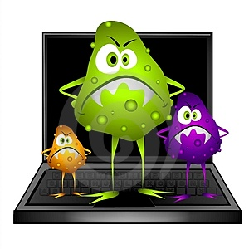
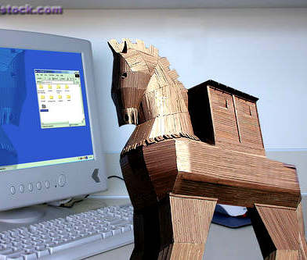
Software & Network Risks

Slide 8
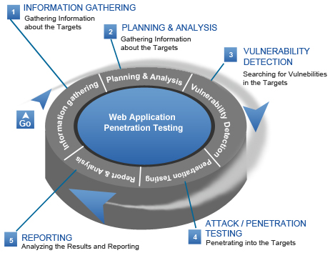
Penetration Tests Stages (When Needed)

Slide 9
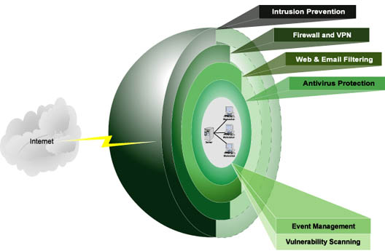
Layered Security

Slide 10
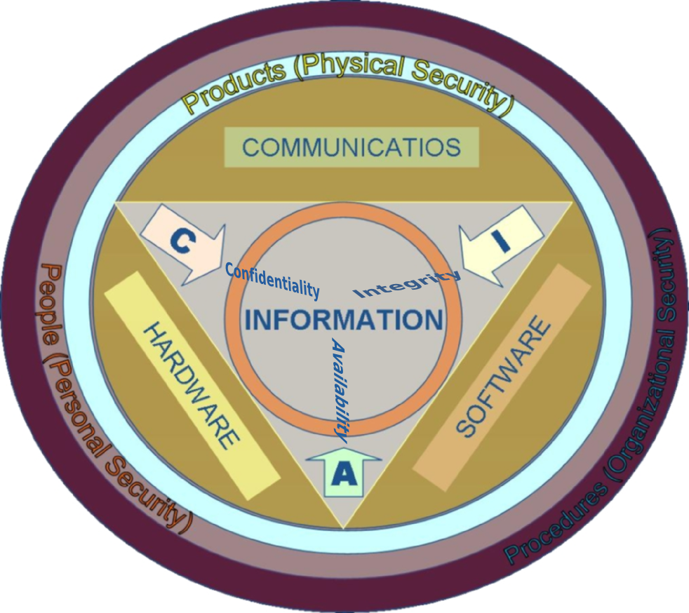
Layered Security

Slide 11
Security Awareness/Culture
Security is everyone’s responsibility
All levels of management accountable
Everyone should consider in their daily roles
Attitude (willing/aims/wants/targets)
Knowledge (what to do?)
Skill (how to do?)
Security is integrated into all operations
Security performance should be measured
Notes:
Need to explain:
what the program will be trying to accomplish,
how it will aim to improve the operations of the company, and
how vital the protection of Information Assets really is.
You will need to explain why "Security is everyone's responsibility", and ensure everybody understands it;
explain that even if the company has the latest technological improvements like firewalls, intrusion detection systems, etc., an uneducated staff member could easily endanger sensitive information, and render any technical security measure in place, completely and utterly useless.
Majority of people often tend to think that it is not their responsibility to help improve the security of their company.
Generally people are of the (wrong) opinion that only the IT department or Information Security Office (ISO) can and need to take care of issues like these.

Slide 12
Security Awareness Program Flow
Company Policy
Security Awareness Program
Integrate
Define
Feedback
Activities
Elicit
Implement
Employees

Slide 13
Benefits of pursuing certification
Allows organizations to mitigate the risk of IS breaches
Allows organizations to mitigate the impact of IS breaches when they occur
In the event of a security breach, certification should reduce the penalty imposed by regulators
Allows organizations to demonstrate due diligence and due care
to shareholders, customers and business partners
Allows organizations to demonstrate proactive compliance to legal, regulatory and contractual requirements
as opposed to taking a reactive approach
Provides independent third-party validation of an organization’s ISMS

Slide 14
Structure of 27000 series
27000 Fundamentals & Vocabulary
27005
Risk
Management
27001:ISMS
27002 Code of Practice for ISM
27003 Implementation Guidance
27004 Metrics & Measurement
27006 Guidelines on ISMS accreditation

Slide 15
What is ISO 27001?
ISO 27001 Part I
Code of practice for Information Security Management (ISM)
Best practices, guidance, recommendations for
Confidentiality ( C )
Integrity ( I )
Availability ( A )
ISO 27001 Part II
Specification for ISM

Slide 16
ISO 27001 Overview
Mandatory Clauses (4 → 8)
All clauses should be applied, NO exceptions
Annex (Control Objectives and Controls )
11 Security Domains (A5 → A 15)
Layers of security
39 Control Objectives
Statement of desired results or purpose
133 Controls
Policies, procedures, practices, software controls and organizational structure
To provide reasonable assurance that business objectives will be achieved and that undesired events will be prevented or detected and corrected
Exclusions in some controls are possible, if they can be justified???

Slide 17
Difference Between 27001:2000 and 27001:2005 Editions? Annex A
2000 Edition (10 sections) | 2005 Edition (11 sections)
Security Policy | A5 - Security Policy
Security Organisation | A6 - Organising Information Security
Asset Classification & Control | A7 - Asset Management
Personnel Security | A8 - Human Resources Security
Physical & Environmental Security | A9 - Physical & Environmental Security
Communications & Operations Management | A10 - Communications & Operations Management
Access Control | A11- Access Control
Systems Development & Maintenance | A12 - Information Systems Acquisition, Development and Maintenance
 | A13 - Information Security Incident Management
Business Continuity Management | A14 - Business Continuity Management
Compliance | A15 - Compliance

Slide 18
ISO 27001 Implementation Steps
Decide on the ISMS scope
Approach to risk assessment
Perform GAP Analysis
Selection of controls
Statement of Applicability
Reviewing and Managing the Risks
Ensure management commitment
ISMS internal audits
Measure effectiveness and performance
Update risk treatment plans, procedures and controls

Slide 19
Plan-Do-Check-Act (PDCA)
The ISO 27001 adopts the “Plan-Do-Check-Act” (PDCA)
Applied to structure all ISMS processes
Plan
Do
Check
Act

Slide 20
PDCA Model
PDCA Model
Plan | Establish ISMS | Establish ISMS policy, objectives, processes and procedures relevant to managing risk and improving IS to deliver results in accordance with an organization’s overall policies and objectives
Do | Implement and operate ISMS | Implement and operate ISMS policy, controls, processes and procedures
Check | Monitor and review ISMS | Asses, and where applicable, measure process performance against ISMS policy, objectives and practical experience and report the results to management for review
Act | Maintain and improve ISMS | Take corrective actions, based on the results of the internal audit and management review or other relevant information, to achieve continual improvement of ISMS

Slide 21
ISO 27001 (Requirements) Standard Content
Introduction
Section 0
Scope
Section 1
Normative references
Section 2
Terms and definitions
Section 3
Plan
Section 4 to plan the establishment of your organization’s ISMS.
Do
Section 5 to implement, operate, and maintain your ISMS.
Check
Sections 6 and 7 to monitor, measure, audit, and review your ISMS.
Act
Section 8 to take corrective and preventive actions to improve your ISMS.
Annex A (Clauses A.5 to A.15)

Slide 22
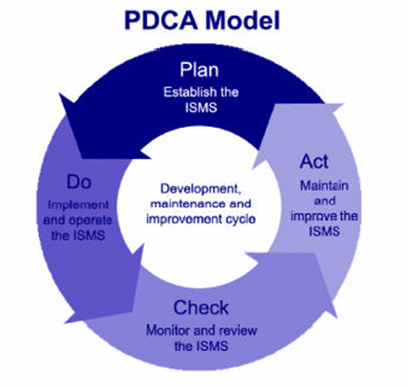
ISO 27001 PDCA Approach
Plan:
Study requirements
Draft an IS Policy
Discuss in IS Forum (committee)
Finalize and approve the policy
Establish implementation procedure
Staff awareness/training
Do:
Implement the policy
Check:
Monitor, measure, & audit the process
Act:
Improve the process

Slide 23
ISMS Scope
Business security policy and plans
Current business operations requirements
Future business plans and requirements
Legislative requirements
Obligations and responsibilities with regard to security contained in SLAs
The business and IT risks and their management

Slide 24
A Sample List of IS Policies
Overall ISMS policy
Access control policy
Email policy
Internet policy
Anti-virus policy
Information classification policy
Use of IT assets policy
Asset disposal policy

